Slide 1
Introducing Social Gaming Elements Into Education
Presented By: Charles Pezanko

Slide 2

What Am I Doing?
Implementing game design mechanics into the classroom with the hopes of increasing student engagement.
Notes:
Can game design in the classroom improve student engagement?
Attempting to continue forward with previous research about Gamification in Education

Slide 3

Clarification
Last time, I screwed up
Unclear definition of Gamification
Let me quickly fix my mistake
Yes, I made Mario cry. Don’t make me feel any worse.
Notes:
Apologize for my lack of clarification. I didn’t provide a clear definition of what gamification really is. I will now rectify that mistake.
Don’t acknowledge the last line, just leave it for people to notice.

Slide 4
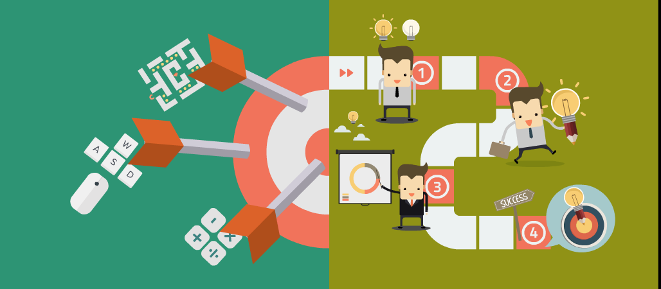
Gamification Vs. Game Based Learning
Game Based Learning
Gamification
The use of actual games in the classroom to reinforce concepts and enhance the learning and teaching experience
The implementation of game design elements and mechanics into a non-gaming context

Slide 5
What I’ve Actually Done So Far
1 Teacher, 1 Science Classroom, 4 Class Sections,
2 Gamified Sections, 2 Non-Gamified Sections

Slide 6
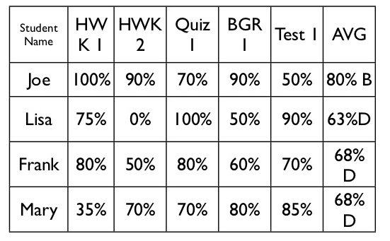

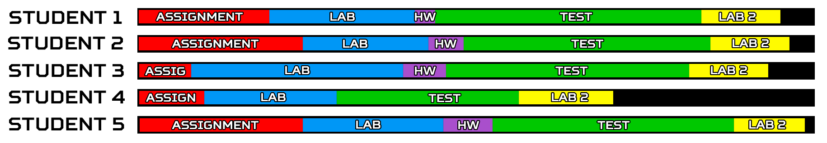
Leveling and Grading
Traditional Grading
Experience Point Grading
Notes:
Instead of an assignment being worth a particular percentile weight like traditional grading, assignments will have their weight simply be the total value they’re worth. So if a tests are worth 30% of the grade, then the values will be higher than a homework assignment. Each black line can be a level and a level up. Possible perks can be implemented here.

Slide 7

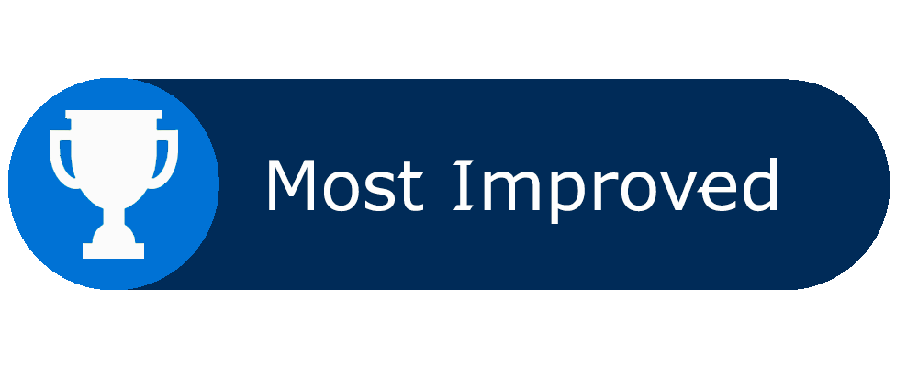




Achievements
What is the value for each of these achievements?

Slide 8



Achievements
1: Always try to allow the player to choose their next course of action
2: If something is worth more, assume the player will go for that first
Notes:
In a classroom environment you don’t have an infinite amount of time. You have to move to the next subject eventually which severely limits the student’s ability to succeed in desired achievement. This also helps make sure some students don’t just completely win over everyone else.

Slide 9
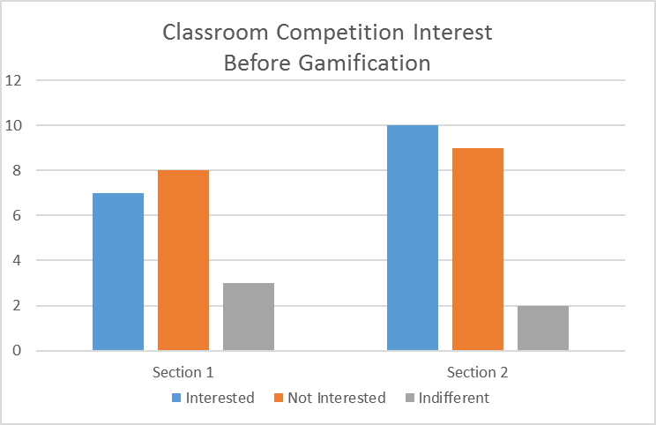
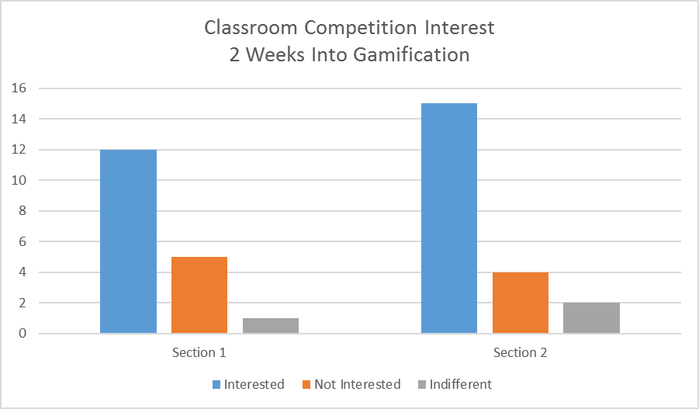
Personal Student Interest

Slide 10
Observations
Good
Not So Good
Less misbehaving during class
Group work is more active and productive
Healthy competition between students during labs
More class time is utilized by students engaging in labs/exercises
More shy students are engaging more
Had to remove “Completed First” Achievement from Lab Work, I don’t know how I didn’t foresee this issue
Can cause an ego in some students

Slide 11

Results / What’s Next?
Survey feelings about the experience
Did students feel compelled to try harder?
Gauge interest from non-gamified sections
Is there more, less, or the same interest now?
Is there a difference in success with gamification?
Worth continuing afterwards?

Slide 12
Questions?
How to accurately calculate grade change and provide proper context?
Is there something I missed going in?
What kind of results are most people interested in?

Slide 13
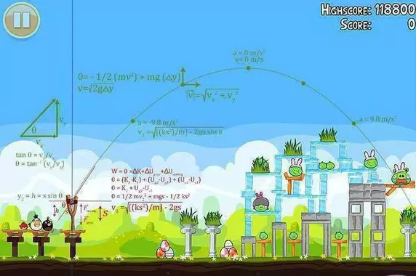
Thank You

Slide 15
Notes 1
Objective of my research
What am I doing?

Slide 16
Notes 2
Background
Significance
Clarification From Last Time

Slide 17
Notes 3 -- What I’ve Done So Far
Implementation
Survey & results
Leveling process
Leveling perks
Achievements
Initially had perks similar to leveling up
If a perk is too strong, then it becomes mandatory
Simply participation progression, completely additional, similar to achievements
Had to adapt to be more towards the leveling processes due to obeying school regulations
Competition during labs
Completion rate, data precision, lab report readability, etc.
Points are awarded to the team, as a whole, but persistent is per student

Slide 18
Notes 4 -- Results So Far
Same Teacher across 4 sections
2 gamified
2 not gamified
Show interest change from gamified sections
Observations
Lab time seems to be much more engaging
Much less downtime from students
Even if a team finishes soon in the race to be done there’s time spent going over results, and in some cases realizing errors and redoing parts of the lab in order to better there results

Slide 19
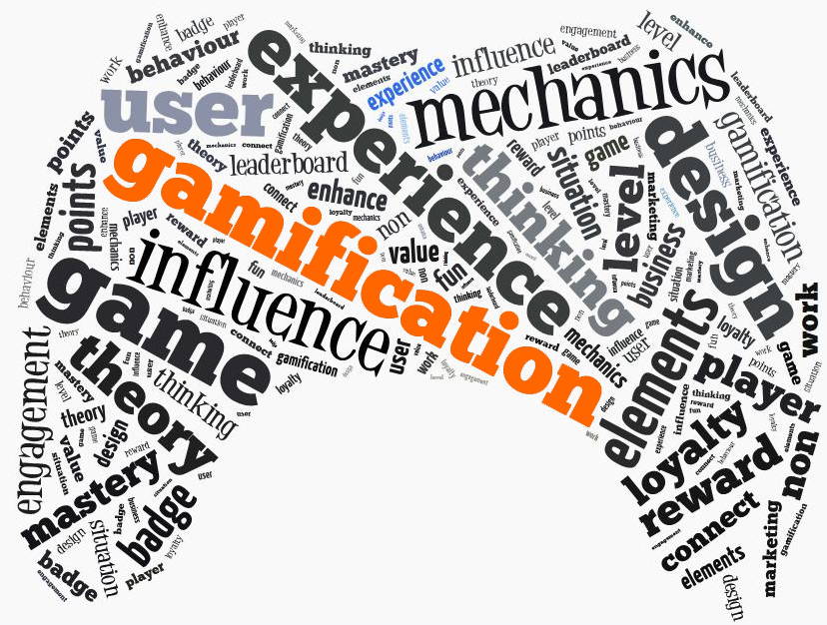
What’s The Point?
Can game design in the classroom improve student engagement?
Further experiment upon previous research
Test and challenge gamification
Is there a reason to continue forward?
Notes:
Scrapped for time

